Slide 1

Chapter 4: Cluster Analysis in Data Mining
Notes:
1

Slide 2
Partitioning-Based Clustering Methods
Objective
Understand the concept of partitioning-based clustering.
Explore the K-Means clustering method and its steps.
Study different techniques for initializing K-Means.
Learn about the K-Medoids clustering method and its advantages.
Discover the K-Medians and K-Modes clustering approaches.
Delve into Kernel K-Means and its application to nonlinear data.
Let's delve into the world of partitioning-based clustering and uncover how these methods contribute to the analysis of diverse datasets.
2

Slide 3
Partitioning-Based Clustering Methods
Partitioning-Based Clustering Methods
Partitioning-based clustering aims to divide data points into non-overlapping clusters. These methods are efficient for large datasets and often involve optimizing a criterion.
Key Concepts:
Partitioning methods optimize the sum of distances between data points and cluster centers.
K-Means is a well-known partitioning-based clustering algorithm.
K-Medoids, K-Medians, and K-Modes are variations of K-Means suited for different data types.
Kernel K-Means extends K-Means to nonlinearly separable data.
3

Slide 4
Partitioning-Based Clustering Methods
The K-Means Clustering Method
K-Means is a widely used partitioning-based clustering algorithm that aims to minimize the sum of squared distances between data points and cluster centroids.
K-Means (MacQueen’67, Lloyd’57/’82)
Each cluster is represented by the center of the cluster
4

Slide 5
Partitioning-Based Clustering Methods
The K-Means Clustering Method
Given K, the number of clusters, the K-Means clustering algorithm is outlined as follows
Select K points as initial centroids
Repeat
Form K clusters by assigning each point to its closest centroid
Re-compute the centroids (i.e., mean point) of each cluster
Until convergence criterion is satisfied
Different kinds of measures can be used
Manhattan distance (L1 norm), Euclidean distance (L2 norm), Cosine similarity
5

Slide 6
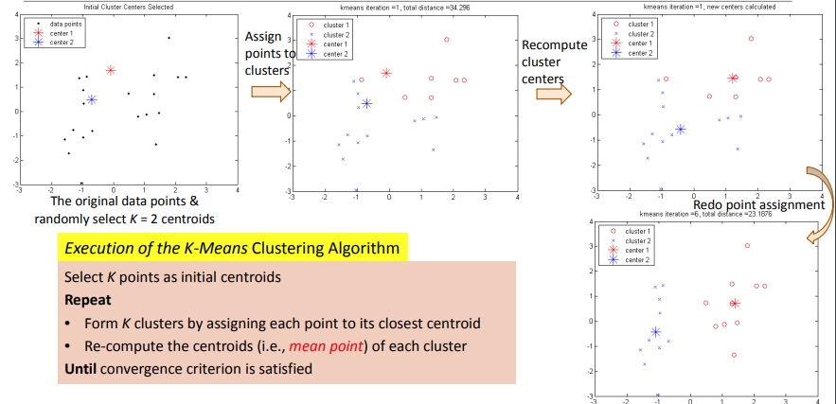
Partitioning-Based Clustering Methods
Example: K-Means Clustering
6

Slide 7
Partitioning-Based Clustering Methods
Discussion on the K-Means Method
Efficiency: O(tKn) where n: # of objects, K: # of clusters, and t: # of iterations
Normally, K, t << n; thus, an efficient method
K-means clustering often terminates at a local optimal
Initialization can be important to find high-quality clusters
Need to specify K, the number of clusters, in advance
There are ways to automatically determine the “best” K
In practice, one often runs a range of values and selected the “best” K value
7

Slide 8
Partitioning-Based Clustering Methods
Discussion on the K-Means Method
Sensitive to noisy data and outliers
Variations: Using K-medians, K-medoids, etc.
K-means is applicable only to objects in a continuous n-dimensional space
Using the K-modes for categorical data
Not suitable to discover clusters with non-convex shapes
Using density-based clustering, kernel K-means, etc.
8

Slide 9
Partitioning-Based Clustering Methods
Variations of K-Means
There are many variants of the K-Means method, varying in different aspects
Choosing better initial centroid estimates
K-means++, Intelligent K-Means, Genetic K-Means
Choosing different representative prototypes for the clusters
K-Medoids, K-Medians, K-Modes
Applying feature transformation techniques
Weighted K-Means, Kernel K-Means
9

Slide 10
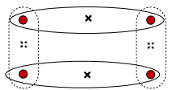
Partitioning-Based Clustering Methods
Initialization of K-Means
Different initializations may generate rather different clustering results (some could be far from optimal)
Original proposal (MacQueen’67): Select K seeds randomly
Need to run the algorithm multiple times using different seeds
There are many methods proposed for better initialization of k seeds
K-Means++ (Arthur & Vassilvitskii’07):
The first centroid is selected at random
The next centroid selected is the one that is farthest from the currently selected (selection is based on a weighted probability score)
The selection continues until K centroids are obtained
10

Slide 11
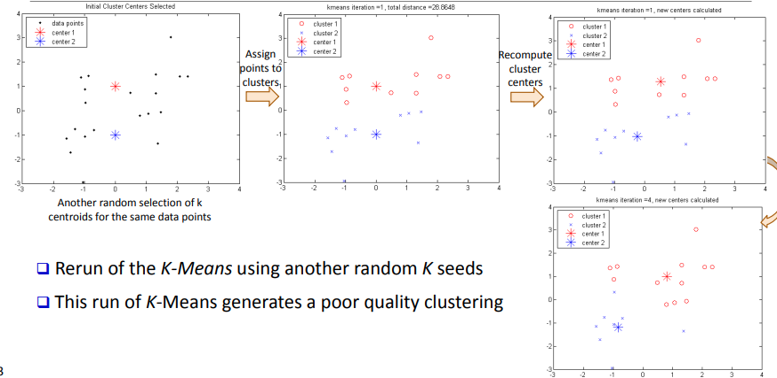
Partitioning-Based Clustering Methods
Example: Poor Initialization May Lead to Poor Clustering
11

Slide 12
Partitioning-Based Clustering Methods
Handling Outliers: From K-Means to K-Medoids
The K-Means algorithm is sensitive to outliers!—since an object with an extremely large value may substantially distort the distribution of the data
K-Medoids: Instead of taking the mean value of the object in a cluster as a reference point, medoids can be used, which is the most centrally located object in a cluster
12

Slide 13
Partitioning-Based Clustering Methods
Handling Outliers: From K-Means to K-Medoids
The K-Medoids clustering algorithm:
Select K points as the initial representative objects (i.e., as initial K medoids)
Repeat
Assigning each point to the cluster with the closest medoid
Randomly select a non-representative object oi
Compute the total cost S of swapping the medoid m with oi
If S < 0, then swap m with oi to form the new set of medoids
Until convergence criterion is satisfied
13

Slide 14
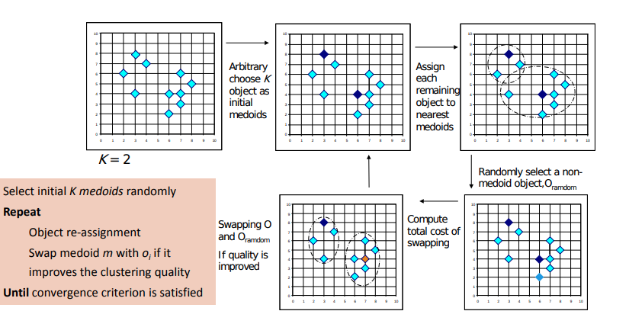
Partitioning-Based Clustering Methods
PAM: A Typical K-Medoids Algorithm
14

Slide 15
Partitioning-Based Clustering Methods
Discussion on K-Medoids Clustering
K-Medoids Clustering: Find representative objects (medoids) in clusters
PAM (Partitioning Around Medoids: Kaufmann & Rousseeuw 1987)
Starts from an initial set of medoids, and
Iteratively replaces one of the medoids by one of the non-medoids if it improves the total sum of the squared errors (SSE) of the resulting clustering
PAM works effectively for small data sets but does not scale well for large data sets (due to the computational complexity)
Computational complexity: PAM: O(K(n − K)2) (quite expensive!)
15

Slide 16
Partitioning-Based Clustering Methods
Discussion on K-Medoids Clustering
Efficiency improvements on PAM
CLARA (Kaufmann & Rousseeuw, 1990):
PAM on samples; O(Ks2 + K(n − K)), s is the sample size
CLARANS (Ng & Han, 1994): Randomized re-sampling, ensuring efficiency + quality
16

Slide 17
Partitioning-Based Clustering Methods
The K-Medians and K-Modes Clustering Methods
K-Medians and K-Modes are extensions of K-Means that cater to specific data types and requirements.
K-Medians:
Uses medians of attribute values as cluster representatives.
Robust to outliers and non-normal data.
K-Modes:
Suited for categorical data.
Finds modes (most common values) as cluster representatives.
Utilizes dissimilarity measures suitable for categorical attributes.
17

Slide 18

Partitioning-Based Clustering Methods
K-Medians: Handling Outliers by Computing Medians
Medians are less sensitive to outliers than means
Think of the median salary vs. mean salary of a large firm when adding a few top executives!
K-Medians: Instead of taking the mean value of the object in a cluster as a reference point, medians are used (L1-norm as the distance measure)
The criterion function for the K-Medians algorithm:
18

Slide 19
Partitioning-Based Clustering Methods
K-Medians: Handling Outliers by Computing Medians
The K-Medians clustering algorithm:
Select K points as the initial representative objects (i.e., as initial K medians)
Repeat
Assign every point to its nearest median
Re-compute the median using the median of each individual feature
Until convergence criterion is satisfied
19

Slide 20
Partitioning-Based Clustering Methods
K-Modes: Clustering Categorical Data
K-Means cannot handle non-numerical (categorical) data
Mapping categorical value to 1/0 cannot generate quality clusters for highdimensional data
K-Modes: An extension to K-Means by replacing means of clusters with modes
Dissimilarity measure between object X and the center of a cluster Z
Φ(xj , zj ) = 1 – nj r /nl when xj = zj ; 1 when xj ǂ zj
where zj is the categorical value of attribute j in Zl , nl is the number of objects in cluster l, and nj r is the number of objects whose attribute value is r
20

Slide 21
Partitioning-Based Clustering Methods
K-Modes: Clustering Categorical Data
This dissimilarity measure (distance function) is frequency-based
Algorithm is still based on iterative object cluster assignment and centroid update
A fuzzy K-Modes method is proposed to calculate a fuzzy cluster membership value for each object to each cluster
A mixture of categorical and numerical data: Using a K-Prototype method
21

Slide 22
Partitioning-Based Clustering Methods
Kernel K-Means Clustering
Kernel K-Means extends the K-Means algorithm to nonlinearly separable data by mapping it to a higher-dimensional space.
Kernel Trick:
Maps data points to a higher-dimensional space using a kernel function.
In the transformed space, data may become linearly separable.
Applies the standard K-Means algorithm in the transformed space.
Application and Benefits:
Effective for data with complex shapes and patterns.
Allows clustering in feature spaces that are not explicitly defined.
22

Slide 23
Partitioning-Based Clustering Methods
Kernel K-Means Clustering
Kernel K-Means to detect non-convex clusters ( K-Means only to linearly separable )
Idea: Project data onto the high-dimensional kernel space, and then perform K-Means clustering
Map data points in the input space onto a high-dimensional feature space using the kernel function
Perform K-Means on the mapped feature space
Computational complexity is higher than K-Means
Need to compute and store n x n kernel matrix generated from the kernel function on the original data
The widely studied spectral clustering can be considered as a variant of Kernel K-Means clustering
23

Slide 24




Partitioning-Based Clustering Methods
Kernel Functions and Kernel K-Means Clustering
Typical kernel functions:
Polynomial kernel of degree h:
Gaussian radial basis function (RBF) kernel:
Sigmoid kernel:
The formula for kernel matrix K for any two points xi , xj є Ck is
24

Slide 25


Partitioning-Based Clustering Methods
Kernel Functions and Kernel K-Means Clustering
The SSE criterion of kernel K-means:
The formula for the cluster centroid:
Clustering can be performed without the actual individual projections φ(xi ) and φ(xj ) for the data points xi , xj є Ck
25

Slide 26

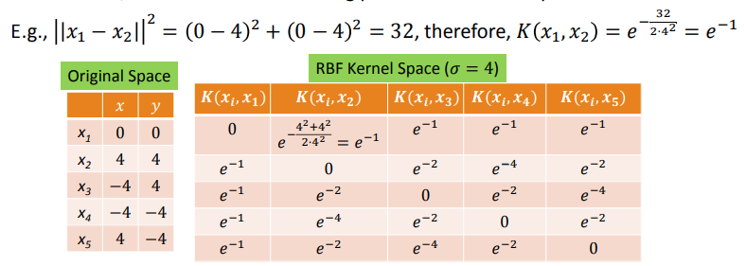
Partitioning-Based Clustering Methods
Example: Kernel Functions and Kernel K-Means Clustering
Gaussian radial basis function (RBF) kernel: K(Xi , Xj ) =
Suppose there are 5 original 2-dimensional points:
x1(0, 0), x2(4, 4), x3(-4, 4), x4(-4, -4), x5(4, -4)
If we set 𝜎 to 4, we will have the following points in the kernel space
26

Slide 27
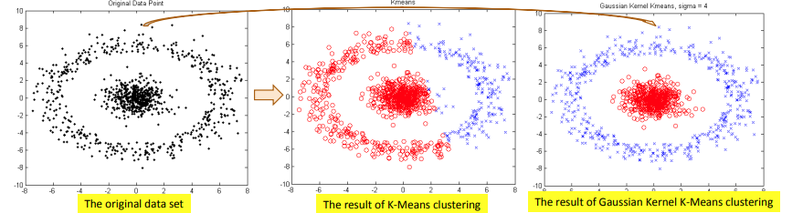


Partitioning-Based Clustering Methods
Example: Kernel K-Means Clustering
The above data set cannot generate quality clusters by K-Means since it contains non-covex clusters
Gaussian RBF Kernel transformation maps data to a kernel matrix K for any two points xi , xj :
and Gaussian kernel:
K-Means clustering is conducted on the mapped data, generating quality clusters
27

Slide 28
Partitioning-Based Clustering Methods
Comparing K-Means, K-Medoids, and K-Modes
K-Means:
Uses centroids as cluster representatives.
Sensitive to outliers and noise.
Efficient for large datasets.
Euclidean distance commonly used.
K-Medoids:
Uses actual data points (medoids) as representatives.
Robust to outliers and noise.
More interpretable and robust.
28

Slide 29
Partitioning-Based Clustering Methods
Comparing K-Means, K-Medoids, and K-Modes
K-Modes:
Caters to categorical data.
Identifies modes as representatives.
Applicable for nominal and ordinal data.
Understanding the differences and trade-offs between these methods helps in selecting the right approach for your clustering task.
29

Slide 30
Partitioning-Based Clustering Methods
Practical Applications and Beyond
Partitioning-based clustering methods find applications in diverse domains beyond traditional data mining.
Applications:
Customer segmentation for targeted marketing.
Image compression using vector quantization (K-Means).
Document clustering for topic discovery.
Disease subtyping in healthcare research.
Anomaly detection for cybersecurity.
The versatility of partitioning-based methods makes them indispensable tools in various data analysis tasks.
30

Slide 31
Partitioning-Based Clustering Methods
Recap and Key Takeaways
In this lesson, we explored Partitioning-Based Clustering Methods:
K-Means partitions data based on squared distances to centroids.
Initialization methods influence K-Means convergence and results.
K-Medoids uses data points as medoids for robustness.
K-Medians and K-Modes cater to specific data types.
Kernel K-Means extends clustering to nonlinear data.
Challenges include initialization sensitivity and K estimation.
Evaluation methods ensure reliable clustering outcomes.
31

Slide 32
Summary
Partitioning Clustering
K-Means and K-Medoids methods.
Application to diverse datasets.
Explore cluster boundaries.
32

